Slide 1
CS 3186
Regular Grammars
Section 3.3

Slide 2





Notation (described earlier)
Grammar
Set of variables
Set of terminal symbols
Start variable
Set of Production rules

Slide 3
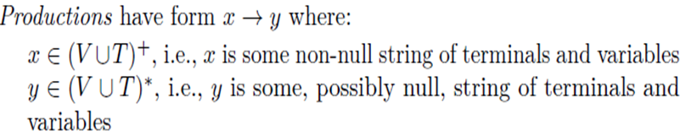
Production rules
Recall from Chapter 1, that the general form of
For Regular Grammars, there is a severe restriction on the production rules. i.e., on both “x” and “y”.
x can only be one variable
Y can contain only have at most one variable and more restriction on where the variable can occur.
Regular grammars are further described by first defining a class of Linear Grammars.

Slide 4
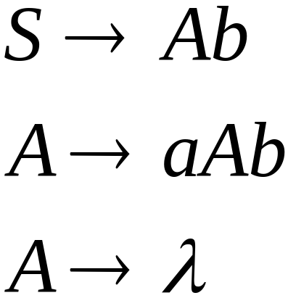
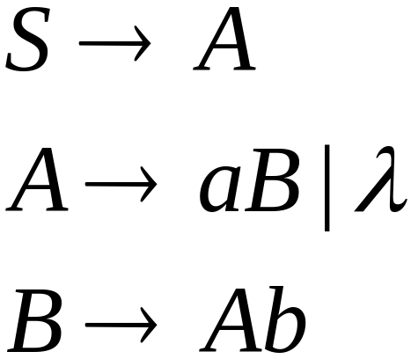
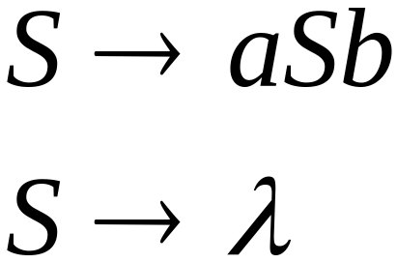
Linear Grammars
Linear Grammar: Grammars with one variable on the left side and at most one variable at the right side of a production
Examples:

Slide 5

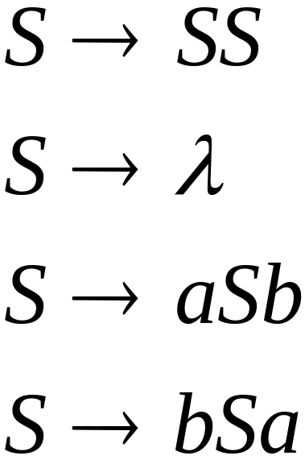
A Non-Linear Grammar
Grammar :

Slide 6
Linear Grammars
Linear Grammars can be right linear grammars or left linear grammars depending on the position of the non terminal in the production rule.

Slide 7


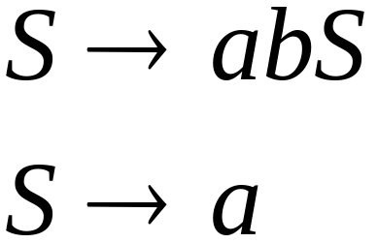
Right-Linear Grammars
All productions have form:
Example:
or
string of
terminals
Note: The non terminal is the right most symbol in the production rule.

Slide 8

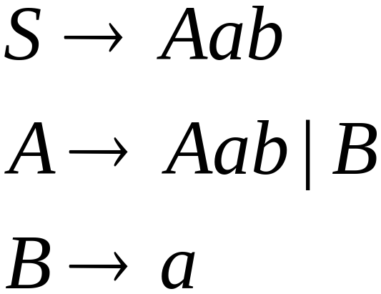
Left-Linear Grammars
All productions have form:
Example:
or
string of
terminals
Note: The non terminal is the left most symbol in the production rule

Slide 9
Regular Grammars

Slide 10

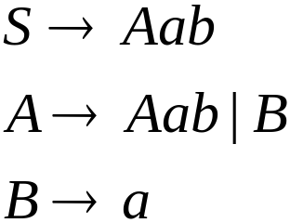
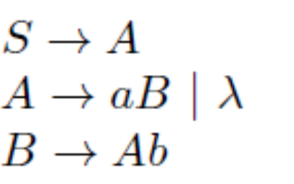
Regular Grammars
A regular grammar is any right-linear or left-linear grammar (If a grammar mixes the concepts of right and left linearity, it is not a regular grammar)
Examples for regular grammars ({S}, {a, b}, S, P) with P given by
Example of a non regular grammar ({S}, {a, b}, S, P) with P given by

Slide 11
Regular Grammars and
Regular Languages

Slide 12

Theorem
Languages
Generated by
Regular Grammars
Regular
Languages
Regular grammars generates Regular languages.
Regular grammars for Regular languages
Both (1) and (2) are proven by construction

Slide 13
Note:
Regular grammars: Consider right-linear grammars.
Regular languages: There exists a nfa or dfa that accepts the language.
We seek to show the equivalence of language generated by right-linear grammar and language accepted by a nfa.

Slide 14
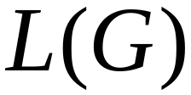

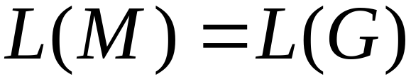
Regular grammars generates Regular languages
Let be a right-linear grammar
We will prove: is regular
Proof idea: We will construct NFA
with

Slide 15
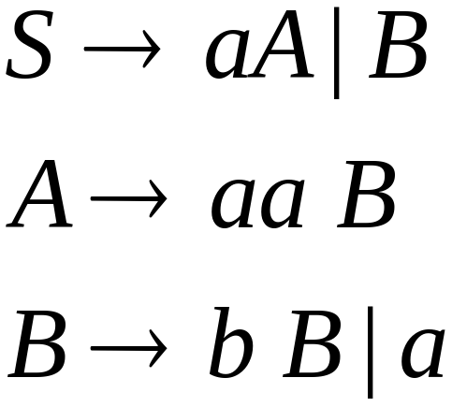
Example
Grammar is right-linear
Example:

Slide 16


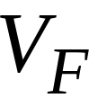

Example (continued)
Construct NFA such that
every state is a grammar variable:
special
final state

Slide 17


Example (continued)
Construction procedure: Add edges for each production as follows

Slide 18

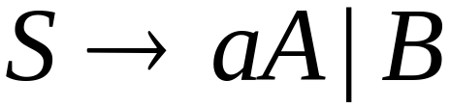
Example (continued)

Slide 19
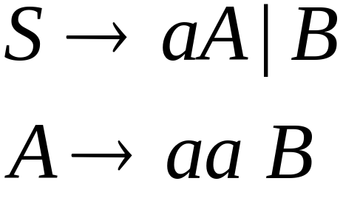
Example (continued)

Slide 20
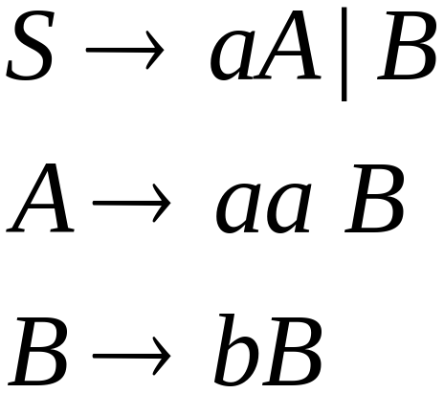

Example (continued)

Slide 21
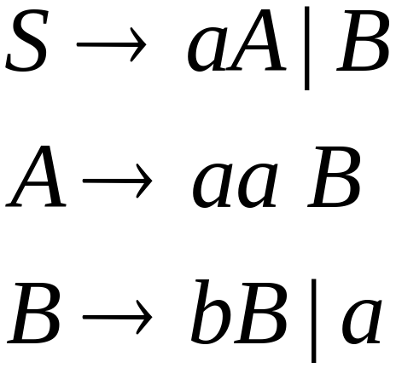
Example (continued)

Slide 22
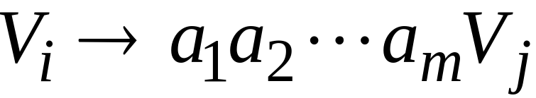
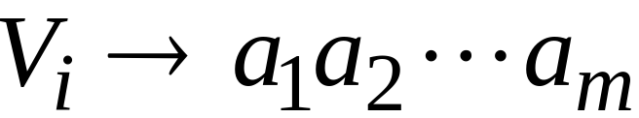
Theorem
Theorem: Let G = (V,T,S,P) be a right-linear grammar. Then L(G) is a regular language.
Proof: By construction of NFA.
Let V = {V₀, V₁,…}; S= V₀ ;
Productions P are of the form

Slide 23






Proof (continued)
We construct the NFA such that:
each variable corresponds to a node:
special
final state

Slide 24


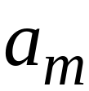


Proof (continued)
For each production:
we add transitions and intermediate nodes
………

Slide 25






Proof (continued)
For each production:
we add transitions and intermediate nodes
Resulting NFA may look like this
………

Slide 26

Proof (continued)
If w ∈ L(G), then there is a path in the NFA (by construction) from V₀ to V_{F}
If w is accepted by the NFA, then by construction, we can produce a derivation sequence V₀ w
Then L(G) = L(M)

Slide 27
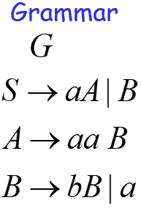
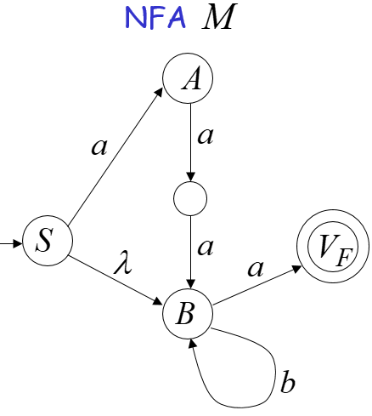
Previous Example
For the derivation sequence for w=aaaba
There exists a path from S to V_{F} on w=aaaba
If w ∈ L(G) then w ∈ L(M)

Slide 28

Previous Example
There is a path from S to V_{F} on w=ba
Then there is a corresponding derivation sequence
If w ∈ L(M) then w ∈ L(G)

Slide 29
The case of Left-Linear Grammars
Let G be a left-linear grammar
We can construct an equivalent right-linear grammar. (skip this construction proof)
Hence, the language L(G) generated by any regular grammar (left-linear or right-linear) is regular.

Slide 30
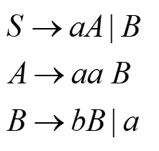
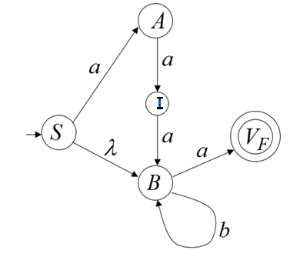
Previous Example
Given G= ({S,A,B},{a,b},S,P} where P:
Constructed an equivalent nfa ({S,A,I,B,V_{f}},{a,b}, ,S,V_{f}), where is given by the transition graph:

Slide 31
Regular Grammars for Regular Languages
Theorem: If L is a regular language over then there exists a right-linear grammar G=(V, , ,S,P), such that L=L(G)
Proof: (By construction) The idea is to start with the finite acceptor (DFA or NFA) of the language and reverse the earlier construction. i.e., the states of the acceptor become the variables, and the symbols causing the transitions become the terminals in the grammar.

Slide 32

Proof (continued)
Let finite acceptor accept L. Assume that Q= (q₀,q₁,…q_{n}) and let =(a₁,a₂,…a_{m}).
Construct the right-linear grammar G=(V, ,S,P), with V=(q₀,q₁,…q_{n}) and S = q₀
For each transition (q_{i},a_{j}) = q_{k} of M, add a production in P q_{i} a_{j} q_{k}
If q_{f} is in F, add q_{f}

Slide 33



Proof (continued)
If w= a_{i},a_{j},…a_{k}a_{f} ∈ L. For M to accept this string, there exists a path (make moves in M)
(q₀,a_{i}) = q_{p} (q_{p},a_{j}) = q_{r …………….} (q_{s},a_{i}) = q_{t} (q_{s},a_{f}) = q_{f} ∈ F
By construction, there will be productions for each of the ‘s. i.e., of the form q_{x} a_{y} q_{z}
We can make a derivation q₀ a_{i} q_{p ……} a_{i},a_{j},…a_{k}a_{f} with the grammar G and w ∈ L(G)
Conversely, if w ∈ L(G), then there is a derivation of the form q₀ a_{i} q_{p ……} a_{i},a_{j},…a_{k}a_{f} . This implies that
(q₀, a_{i},a_{j},…a_{k}a_{f} ) = q_{f .} This implies a_{i},a_{j},…a_{k}a_{f} is accepted.

Slide 34
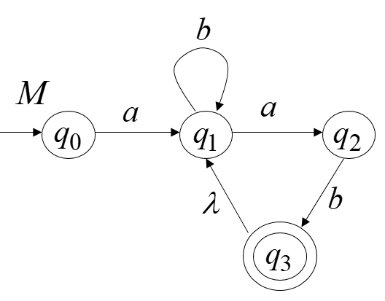
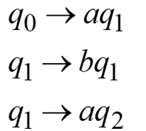
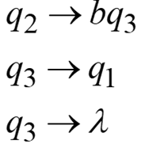
Example
Given an NFA, M
Where Q={q₀,q₁,q₂,q₃},
=(a,b}, F={q₃}, given by
The equivalent right-linear grammar, G is
({q₀,q₁,q₂,q₃}, {a,b},q₀,P), where P are defined by

Slide 35
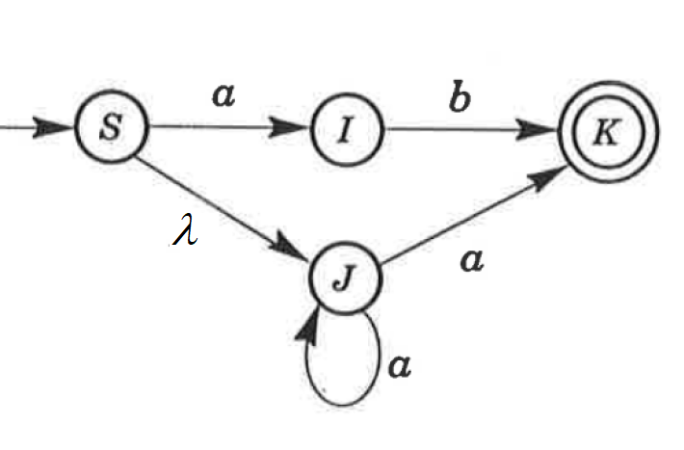
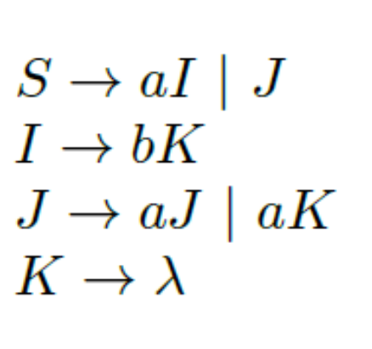
Another Example
Given an NFA,
The equivalent right-linear grammar G=({S,I,J,K}, (a,b}, S, P) where P are defined by:

Slide 36
Summary
Regular languages (expressed as Regular expressions or accepted by NFA) and Regular grammars are equivalent.
NFA and DFA are equivalent.
The construction algorithms in this chapter enable us to convert back and forth between the various representations of Regular languages (Regular expression, NFA or DFA, Regular Grammars)

Slide 37
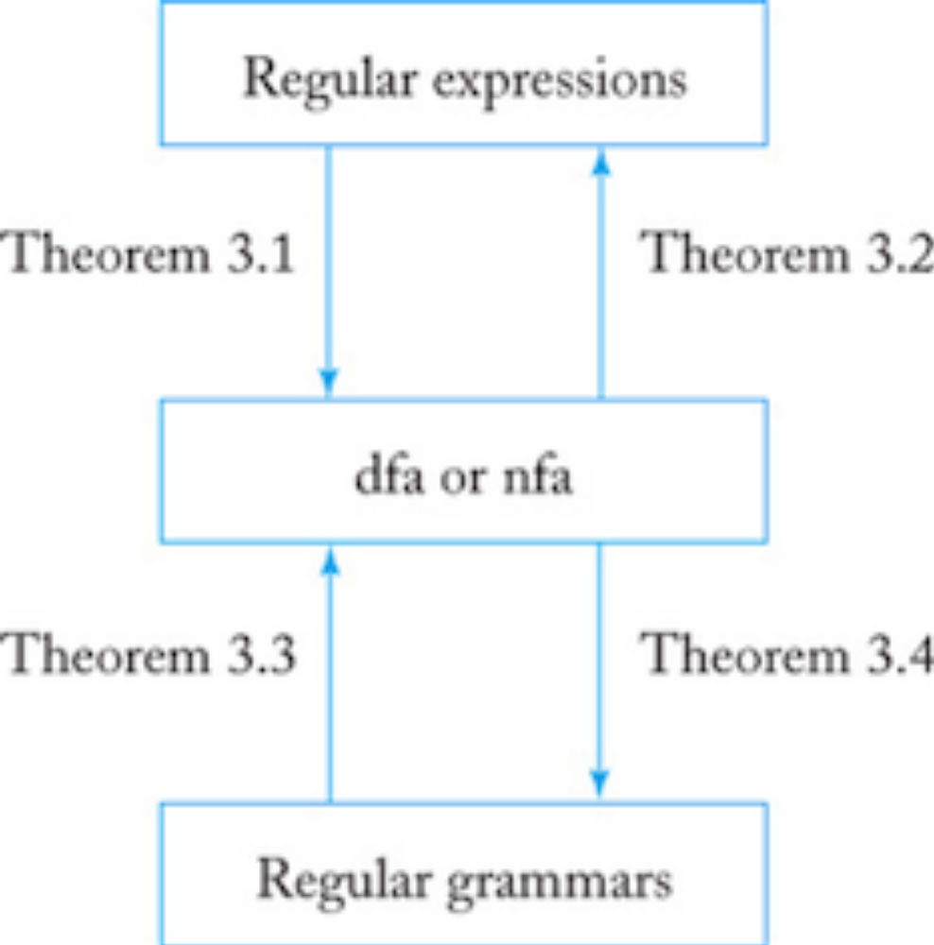
Summary

Slide 38
(I) Do Exercises: # 1,2
(II) Write an NFA for L and then convert to a right-linear grammar for Exercises: #3, #6
(III) Write a right-linear grammar for Exercise #10
(IV) Write a right linear grammar for the NFA described in Exercise #1, #2, #3,#10, #12 (Section 3.2)
(V) Consider the grammar G=( {S, A},{a,b}, S, P) with P given by:
S → aS|bA A → bA A → λ
Construct an equivalent NFA
(V) Construct an equivalent NFA for the grammar below
S → λ S → aT S → bT T → a T → b T → aS T → bS
Homework 3.3

